Slide 1
Models of Animated Rivers for the Interactive Exploration of Landscapes
Grenoble Institute of Technology (INPG)
a Ph.D. Defense by
Qizhi Yu
Under the Advisements of
Dr. Fabrice Neyret
Dr. Eric Bruneton
November 17, 2008

Slide 2
Outline
Introduction
Previous work
Strategy overview
Contributions
Conclusion

Slide 3
Outline
Introduction
Previous work
Strategy overview
Contributions
Conclusion

Slide 4
Introduction Research on rivers
Rivers
Hydrology
Geomorphology
Ecology
Hydraulics

Slide 5
Introduction Research on rivers
Rivers
Hydraulics
Hydrology
Geomorphology
Ecology
Computer graphics
Notes:
.

Slide 6
Introduction Study of rivers in CG
Objective
Synthesize visually convincing rivers
Study content
Modeling
River shape & surface details
Animating
Water motion in rivers.
Notes:
Generally, the purpose of the study of rivers in computer graphics is to synthesize visually convincing rivers.
For this purpose, we need to model the shape of rivers and surface details, in addition, we need to model the water motion in rivers.
Rendering of water is out of the range

Slide 7
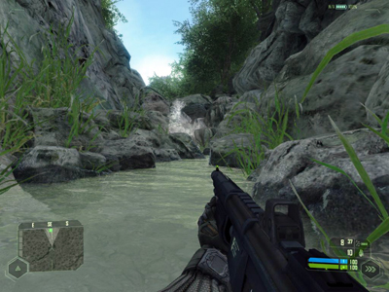
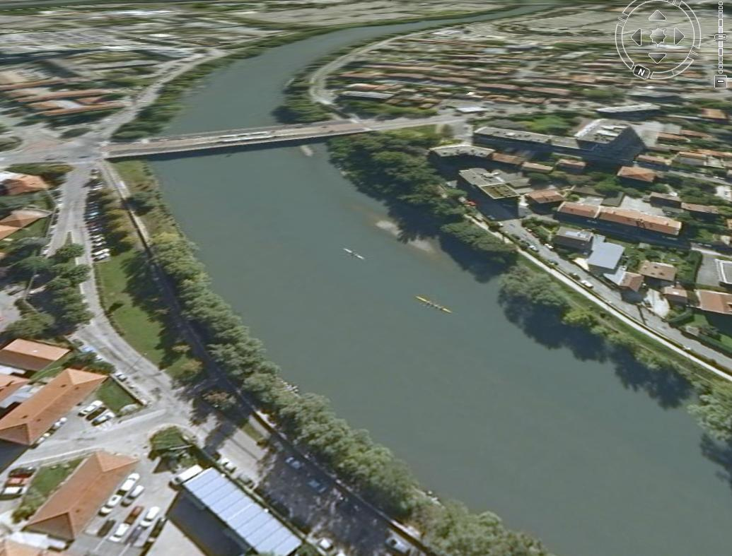
Introduction Rivers in CG applications
Many applications, need more studies
Google Earth
EA: Crysis
Notes:
Nowadays, more and more computer graphics applications have the ambitious to present virtual but realistic natural scenes. In these scenes, rivers is an important feature.
However, rivers in current applications are still not realistic enough, especially in the real-time case.
For example, in the video game Crysis, rendering of water is good, but the water can pass through solid boundaries, which is not natural.
Moreover, river animatin is particully difficult in a very large scene.
For example, Google Earth a GIS application, that allows users to navigate in the whole world.
But rivers in Google earth is static.
Therefore, we need more studies of rivers in computer graphics, especially for the real-time case.

Slide 8
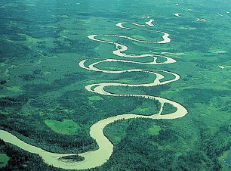
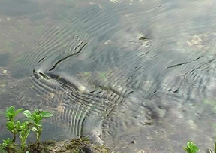
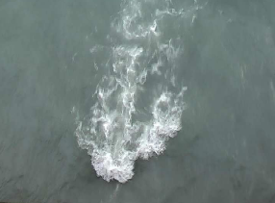
Introduction Challenges
Multi-scale
Geometry
Kilometer-scale length millimeter-scale waves
Water motion
Kilometer-scale mean flow millimeter-scale fluctuation
Complicated physics
Turbulence → Surface phenomena

Slide 9
Introduction My research goal
Modeling and animating rivers
Constraints
Real-time
Scalability
Controllability
Realism
25 fps or more

Slide 10
Introduction My research goal
Modeling and animating rivers
Constraints
Real-time
Scalability
Controllability
Realism
Very long or unbounded rivers Camera moves arbitrarily
Notes:
Second, we want to handle very long or even unbounded rivers, and , in the scene, the camera can move arbitrarily, the users can observe rivers very closely, or observe rivers far away. All these require our algorithms should be scalable.

Slide 11
Introduction My research goal
Modeling and animating rivers
Constraints
Real-time
Scalability
Controllability
Realism
Intuitive handles for controlling appearance and behavior of rivers

Slide 12
Introduction My research goal
Modeling and animating rivers
Constraints
Real-time
Scalability
Controllability
Realism
Animated surface details
with temporal and spatial continuity

Slide 13
Introduction My research goal
Modeling and animating rivers
Constraints
Real-time
Scalability
Controllability
Realism

Slide 14
Outline
Introduction
Previous work
Strategy overview
Contributions
Conclusion

Slide 15
Previous work
3D Navier-Stokes simulation
2D depth-averaged simulation
2D simulation
Surface wave models (2D)
Notes:
In computer graphics, there is a lot of work on water or surface waves animation. But not too much work specific to river animation.
In addition, In hydraulics field, there is a lot of work on river simulation.
Now we discuss them in 4 categories, according to the visual features they are able to model.
.
.

Slide 16
Previous work
3D Navier-Stokes simulation
2D depth-averaged simulation
2D simulation
Surface wave models (2D)
Notes:
The first is water simulation, in this category, the physical quantities are defined and simulated in 3D.
The second is river simulation, it this category, the physical quantities are averaged in vertical direction, and water depth is considered in the models.
The final category is suface wave models, these models are purly 2D.

Slide 17
Previous work 3D NS simulation: Equations of liquids
Incompressible Navier-Stokes equations
Momentum conservation
Volume conservation
Boundary conditions
Computational Fluid Dynamics (CFD)
Numerical methods

Slide 18
Previous work 3D NS simulation
CFD → CG fluid animation
Stable solver [stam99]
Two approaches
Eulerian : defines quantities at fixed point
Lagrangian: defines quantities at particles
Notes:
The cfd techqniues can be used for animation purpose. Here, an important work is Stam’s stable solver.
% makes the CFD techniques practical for animation problems.
Their method allows large time-steps while being stable. Certaitly, it will loss some accuracy, but it could be accepted in animation.
Note that there are too approaches for solving NS equations. The Eulerian approach, define quantities at fixed points in the sapce. While, the Lagrangian approach defines quantities at particles that follow the flow.
Generally, there are two approaches for solving the ns equations.
Shorten sentences
Stable solver less accurate
One…
with an implicit function
Many work has been done to use CFD tech for the animation purpose
Basically, it includes two steps.
Here we need a stable solver tailored for computer animation. The stable solver proposed by stam are commonly used. The stable solver is important since it allows us to use a large time step while keeping the simulation stable. Certainly, it will loss some physical accurity, but it is basically accepted for the animation purpose.
The level-set method track the interface by advecting an implicit function. It can handle interface with complicated

Slide 19
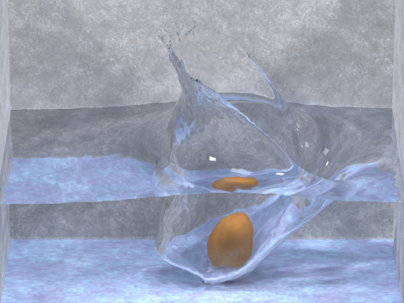
Previous work 3D NS simulation: Eulerian approach
Water animation [EMF02]
Solve NSE numerically on a grid to get velocities
Use level-set to track water-air interface
Notes:
This is a typical water animation work that uses 3D NS queations and Eulerian approach
Water animtion that use NS simulation with Eulerin approch.
First, they solve NSE on a grid to get the velocities. And then, they uses leve-set method to track water-air interface by advecting by advecting an implicit function
Many work has been done to use CFD tech for the animation purpose
Basically, it includes two steps.
Here we need a stable solver tailored for computer animation. The stable solver proposed by stam are commonly used. The stable solver is important since it allows us to use a large time step while keeping the simulation stable. Certainly, it will loss some physical accurity, but it is basically accepted for the animation purpose.
The level-set method track the interface by advecting an implicit function. It can handle interface with complicated

Slide 20
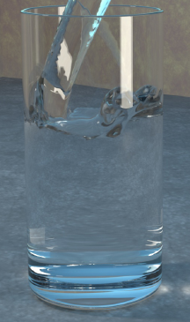
Previous work 3D NS simulation: Eulerian aprroach
Pouring water in a glass [EMF02]
15 minutes per frame
55 x 120 x55 grids
Computationally expensive!

Slide 21
Previous work 3D NS simulation: Eulerian aprroach
Poorly scalable
CG (stable solver): O(N^3)
Difficult to control for artists
Water Behavior ← Initial values, boundary conditions
No intuitive relation

Slide 22
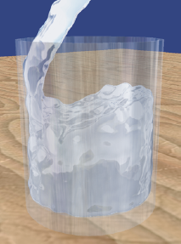
Previous work 3D NS simulation: Lagrangian aprroach
Smoothed Particle Hydrodynamics (SPH) [MCG03]
Solve NSE in the “Lagrangian formalism”
Compared with Eulerian approach
Easier adaptive to complex domain
Difficult to reconstruct a smooth surface
For our purpose
Similar problems as Eulerian approach
2200 particles
5 fps
Notes:
SPH method is a typical Lagrangian approach.
Compared with eulerian approach, it is easier adaptive to complex domain, but it is more dificult to reconstruct a smooth surface from particles.
For our purpose, it also surffers similar problems as the Eulerian.
The method is still expensive.
In this image,
About 2000 particles are used for simulating pouring water in a glass, it runs in 5 fps.
Note that this a very small domain compared with rivers.

Slide 23
Previous work
3D Navier-Stokes simulation
2D depth-averaged simulation
2D simulation
Surface wave models (2D)

Slide 24
Previous work 2D depth-averaged simulation
2D Shallow Water model [Mol95]
Commonly used in Hydraulics for simulating rivers
Assumptions
Hydrostatic approximation
No vertical water motion
Integrate the NS equations along vertical direction
Unknowns:
depth-averaged velocity & elevation of water surface

Slide 25
Previous work 2D depth-averaged simulation
Properties
A lot faster than 3D N-S simulation
Loss some 3D surface features (e.g. overturning )
Shallow waves ( wavelength >> depth)
For our purpose
Still too expensive, especially for large rivers
Bounded domain (like other simulation).

Slide 26
Previous work 2D depth-averaged simulation
Linear wave equation [KM90]
Simplified from shallow water model
Assumptions
constant water depth, no advection term
Properties
Fast, can’t simulate river flow

Slide 27
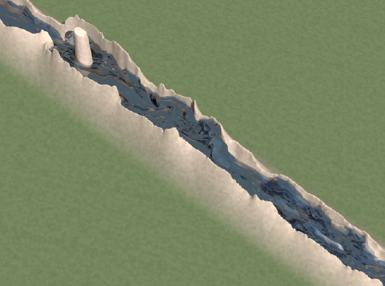
Previous work Combined with 3D NS simulation
[Irving et al. 06]
20 processors
25 minutes per frame

Slide 28
Previous work
3D Navier-Stokes simulation
2D depth-averaged simulation
2D simulation
Surface wave models (2D)
Notes:
.

Slide 29
Previous work 2D simulation: 2D N-S
Simulate 2D velocity by solving 2D N-S
no surface elevation simulated
Use tricks for surface elevation
Pressure [CdVL95]
Noise [TG01]

Slide 30
Previous work
3D Navier-Stokes simulation
2D depth-averaged simulation
2D simulation
Surface wave models (2D)

Slide 31
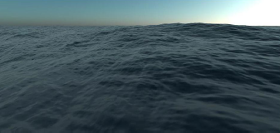
Previous work Wave models: FFT wave [Tes 01]
Assumption
Deep water: wave length << depth
Surface (heighfield) = Σ sine waves
Method
Wave spectrum → FFT → surface elevation
Properties
Fast, nice ocean waves
No water flow, no boundary
We use it as texture examples.

Slide 32
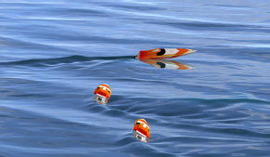
Previous work Wave models: wave particles [YHK07]
Assumption
Height field
A procedural method
Particles on surfaces, advected with a fixed speed
Each carries a wave shape function
Superpose all particles → height field
Properties
Imitate object-water interaction
No water flow

Slide 33
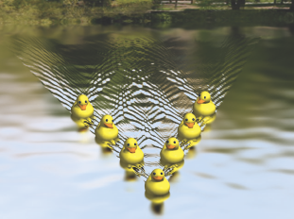
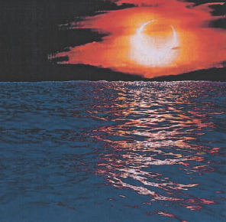
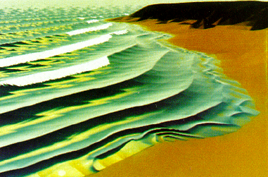
Previous work Wave models: explicit wave trains
Superpose sine waves [FR86, Pea86]
Dynamic wave tracing [GS00]
Ship wave [Gla02]
[Gla02]
[GS00]
[Pea86]
Not for river flow

Slide 34
Previous work: conclusion
Many work on water or wave animation (CG), river simulation (Hydraulics)
None for river animation under our constrains:
Real-time
Scalability
Controllability

Slide 35
Outline
Introduction
Previous work
Strategy overview
Contributions
Conclusion
Notes:
.

Slide 36
Strategy overview
Model river aspects in three scales, from coarse to fine

Slide 37
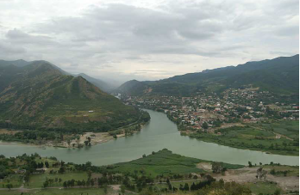
Strategy overview
Model river aspects in three scales
Macro-scale: river shape & mean water surface

Slide 38
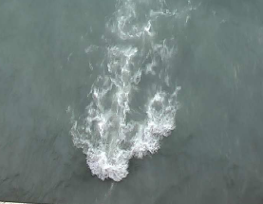
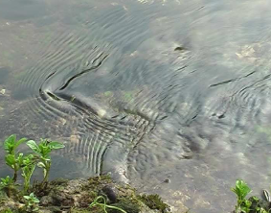
Strategy overview
Model river aspects in three scales
Macro-scale: river shape & mean water surface
Meso-scale: individual & structured waves
Notes:
In the meso scale, we model individual and strcuture dwaves. Such as

Slide 39
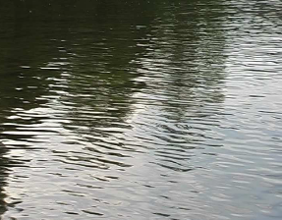
Strategy overview
Model river aspects in three scales
Macro-scale: river shape & mean water surface
Meso-scale: individual & structured waves
Micro-scale: continuous field of small waves

Slide 40
Strategy overview
We need river velocity
Cause of many meso-scale phenomena
Advect surface features
Model water motion in three scales
Macro-scale: mean flow
Meso-scale: individual perturbations
Micro-scale: continuous irregular fluctuations

Slide 41
Strategy overview
We need river velocity
Cause of many meso-scale phenomena
Advect surface features
Model water motion in three scales
Macro-scale: mean flow
Meso-scale: individual perturbations
Micro-scale: continuous irregular fluctuations
We won’t solve ALL phenomena in this thesis .

Slide 42
Outline
Introduction
Previous work
Strategy overview
Contributions
1: Macro-scale
2: Meso-scale
3: Micro-scale
Conclusion

Slide 43
Outline
Introduction
Previous work
Strategy overview
Contributions
1: Macro-scale
2: Meso-scale
3: Micro-scale
Conclusion

Slide 44
Macro-scale
Goal
Shape of rivers
Mean flow of rivers

Slide 45
Macro-scale
GIS or previous work [KMM88]
Goal
Shape of rivers
Mean flow of rivers
Notes:
In this work, we assume that the shape of rivers is available from GIS or previous work.

Slide 46
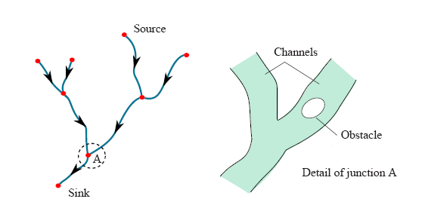
Macro-scale Problem: calculate mean flow
Input
river shape (described as a network)
Notes:
.

Slide 47
Macro-scale Problem: calculate mean flow
Assumption
a 2D steady flow
Visually convincing velocity
Divergence free → Incompressible
Boundary-conforming
Flowing from source to sink (given flow rate Q)
Continuous
Requirements of algorithms
Fast, scalable and controllable

Slide 48
Macro-scale Stream function
Some existing work [BHN07] suggest
using stream function to get divergence-free vector field

Slide 49
Macro-scale Stream function: Imcompressibility
Stream function is defined such that
Incompressibility

Slide 50
Macro-scale Stream function at boundaries
Properties of stream function
Const along boundaries
Relates to the volume flow rate
Extend to a river network
Given flow rates and a river network → all boundary values

Slide 51
Macro-scale Stream function: channel flow
Given flow rates, and boundary values
How to determine the internal field ?
Notes:
Our opportunity is that, in computer animation, we do not need physically accurate velocity. We only need a velocity file that looks like the real river.
First,

Slide 52
Macro-scale Stream function: potential flow
Assumption
Irrotational (potential) flow

Slide 53
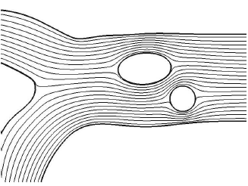
Macro-scale Stream function: potential flow
Observe a numerical solution of a Laplace equation
Streamlines (isocurve of stream function)
Notes:
The streamlines inside look like interpolation of the border.

Slide 54
Macro-scale Stream function field
[GW78]
Interpolant of the Inverse-Distance Weighted interpolation (IDW) [She68] similar to the harmonic functions.
We adapt IDW
local for the performance reasons
provide parameters for controlling velocity profile

Slide 55
Macro-scale Interpolation scheme
d distance to boundaries
f smooth function
s search radius
p parameters

Slide 56
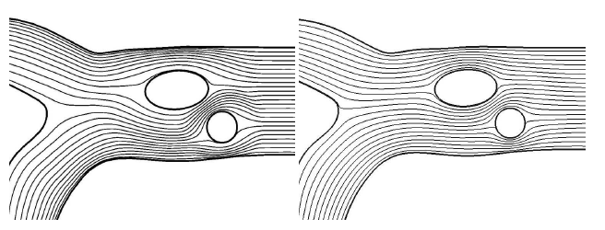
Macro-scale Comparison
Our result Numerical solution

Slide 57
Macro-scale From stream function to velocity
Finite difference

Slide 58
Macro-scale Implementation: distance queries
Interpolation relies heavily on distance query
Acceleration needed
Combine with tile-based terrain [BN07]
Generate an acceleration data structure in each newly created terrain on-the-fly
Please see the thesis for more details.

Slide 59
Macro-scale Result

Slide 60
Macro-scale: conclusion
Procedural river flow
Fast
Scalable
Calculate at needed
Velocity locally dependent
Controllable
Control velocity: flow rates, interpolation parameters
Edit shape of river on-the-fly

Slide 61
Outline
Introduction
Previous work
Strategy overview
Contributions
1: Macro-scale
2: Meso-scale
3: Micro-scale
Conclusion

Slide 62
Meso-scale
Goal
Modeling individual & structured wave features on river surfaces, with our constraints.
Real-time
Scalability
Controllability
Quality
Notes:
Change the color

Slide 63
Meso-scale Quasi-stationary waves
Real scene

Slide 64
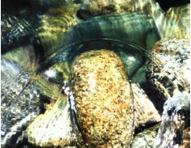
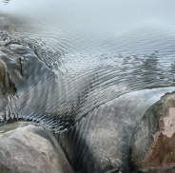
Meso-scale Challenges
High-resolution required for simulation and rendering
Notes:
Simulating this phenomenon is difficult

Slide 65
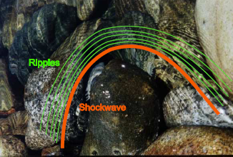
Meso-scale Existing model [NP01]
Construct the vector features from a given velocity field without numerical simulation
Ripples
Shockwave

Slide 66
Meso-scale Existing model [NP01]
Problems
Need to be improved
robustness & efficiency
No solution for surface reconstruction and rendering

Slide 67
Meso-scale My work
Improve on existing model [NP01]
Result
Mean flow → shockwave curves (wave crests)
Animated by adding perturbation to the mean flow
Notes:
So, my first work here is to improve on the existing model
But , I will not introduce the method in this talk.
The main results are:
Given a velocity field, we can get a shockwave curve (crest)
Wave curves animated by perturbating the mean velocity field
Very efficient, easy for keyframing

Slide 68
Meso-scale My work
Macro-scale
Improve on existing model [NP01]
Result
Mean flow → shockwave curves (wave crests)
Animated by adding perturbation to the mean flow
Meso-scale, [WH91]
Notes:
Vector-data, feature-based simulation ->>> It is very efficient. Easy for keyframe, if do not like the simulation.
Pertubation should be considered in meso-scale. And we can use [WH91] work by superposing local analytic velocity field to the mean flow.

Slide 69
Meso-scale My work
Improve on existing model [NP01]
Result
Mean flow → shockwave curves (wave crests)
Animated by adding perturbation to the mean flow
Very efficient

Slide 70
Meso-scale My work
Improve on existing model [NP01]
Construct appropriate representation from wave features for high-quality rendering

Slide 71
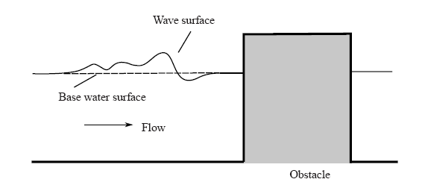
Meso-scale Composite surface
lo-res base water surface + hi-res wave surface

Slide 72
Meso-scale Composite surface
lo-res base water surface + hi-res wave surface
Macro-scale

Slide 73
Meso-scale Composite surface
lo-res base water surface + hi-res wave surface
Meso-scale

Slide 74
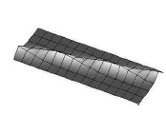
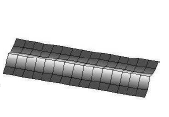
Meso-scale Feature-aligned wave surface
Feature-aligned mesh reduces geometric aliasing ( → normal-noise)
Not feature-aligned
Feature-aligned
Notes:
We consider to construct feature-aligned wave surface.

Slide 75
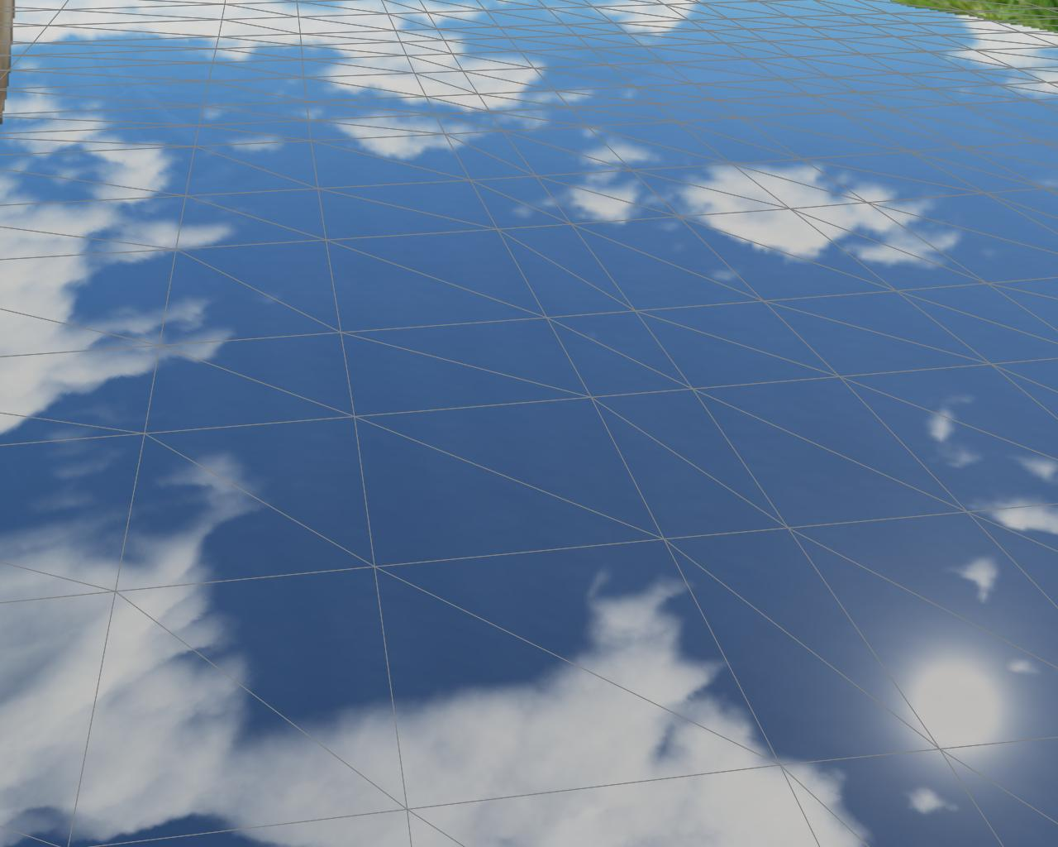
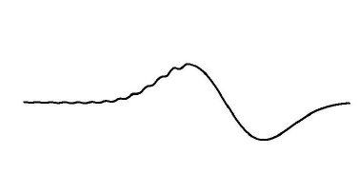
Meso-scale Feature-aligned wave surface
Define wave surface as sweeping a wave profile along the wave curve
Wave curve
Water surface mesh
User defined Wave profile

Slide 76
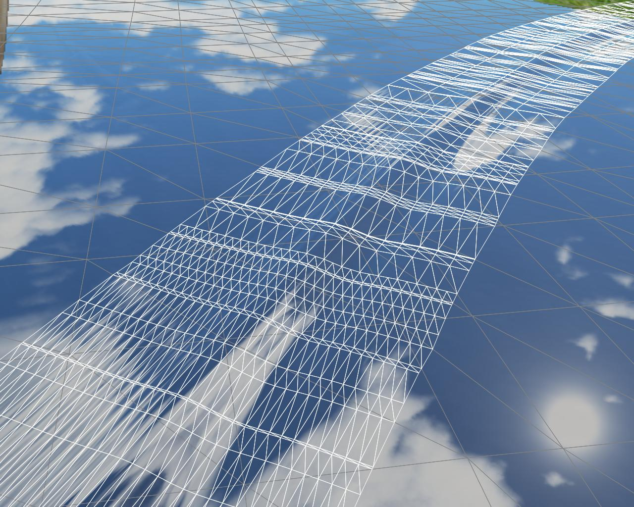
Meso-scale Feature-aligned wave surface
Sample by a quad mesh aligned the wave curve
Wave curve
v

Slide 77
Meso-scale Feature-aligned wave surface
Accurate normals from the wave profile
N
T
v
P(u,v)
B
u
v

Slide 78
Meso-scale Composite wave with base surface
Mesh stitching ?
Re-mesh base surface at each frame, too expensive
We solve it in the rendering stage
Please refer to the thesis for more details

Slide 79
Meso-scale Real-time high-quality rendering
Notes:
Real-time

Slide 80
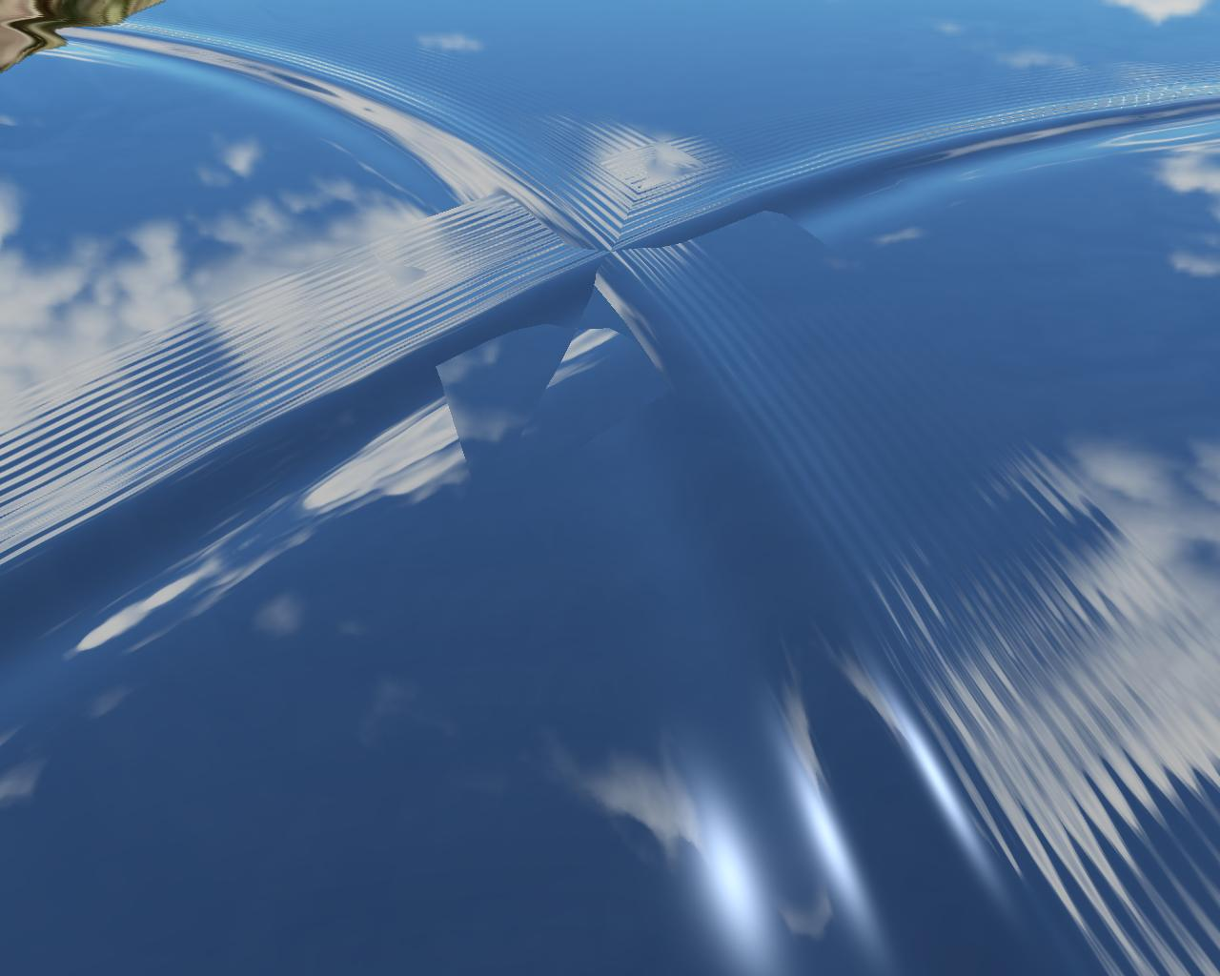
Meso-scale Wave intersection
Simply draw two wave strips with Z-buffer
Notes:
,

Slide 81
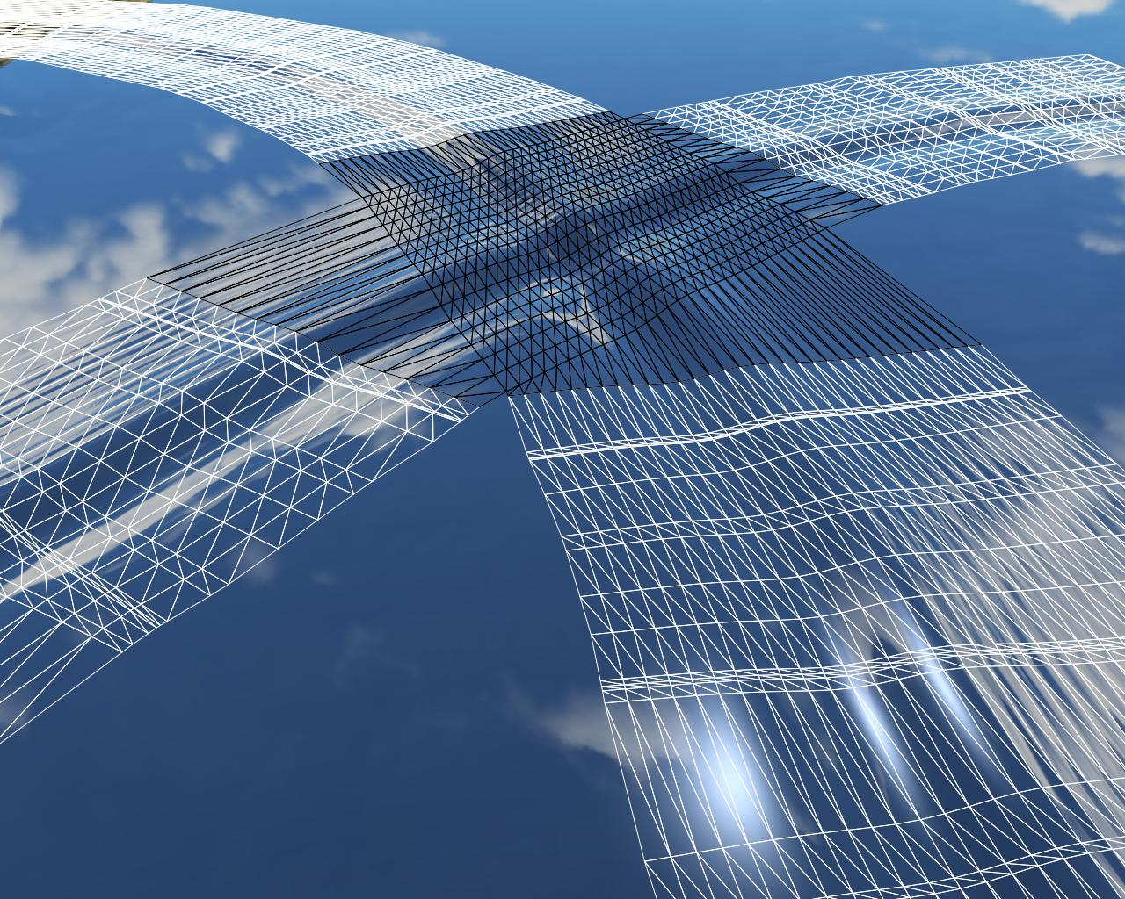
Meso-scale Wave intersection
Generate a dedicated mesh at crossing

Slide 82
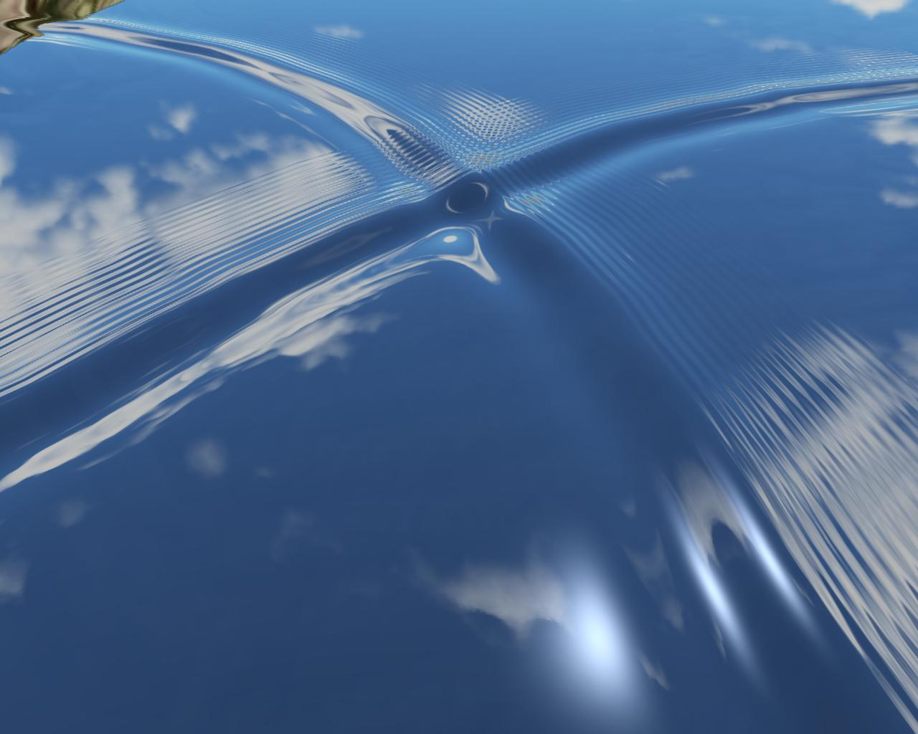
Meso-scale Wave intersection
Final result

Slide 83
Meso-scale Demo

Slide 84
Meso-scale: conclusion
Approach: feature-based vector simulation
Simulation: construct & animate vector features
Rendering: featured-based representation

Slide 85
Outline
Introduction
Previous work
Strategy overview
Contributions
1: Macro-scale
2: Meso-scale
3: Micro-scale
Conclusion

Slide 86
Micro-scale
Goal
Modeling small scale animated surface features
Approach
dynamic textures
Two work
Wave sprites
Focus on performance
Lagrangian texture advection
Focus on quality

Slide 87
Outline
Introduction
Previous work
Strategy overview
Contributions
1. Macro-scale
2. Meso-scale
3. Micro-scale
Wave sprites
Lagrangian texture advection
Conclusion

Slide 88
Micro-scale I Motivation
Sprite: a small textured element
Sprites in texture world [LN03,LHN05]
to get large high-resolution texture , low memory
Idea: combine animation + texture sprites
to get very large river with animated details, efficiently.

Slide 89
Micro-scale I Motivation
How should sprites behave for our purposes ?
Sprites -> represent waves
reconstructed texture should conserve the spectrum
Well distributed, avoiding holes and overcrowding
The more overlapping, the more texture spectrum biasing
The density of sprites should be adaptive
Convey the flow motion
Notes:
Ensure temporally continuous

Slide 90
Micro-scale I Method
Dynamic adaptive sampling
A set of particles in world space advected by flow
Keep Poisson-disk distribution in screen space.
Attach a textured sprite to each particle

Slide 91
Micro-scale I Method
Dynamic adaptive sampling
A set of particles in world space advected by flow
Keep Poisson-disk distribution in screen space.
Attach a textured sprite to each particle
Why ?

Slide 92
Micro-scale I Poisson-disk distribution
Uniform density
Overlapping as little as possible
Easy to ensure spatial continuity
Superimposing sprites (with r=d) ensures no-holes
r
r = d
diameter of poisson-disk

Slide 93
Micro-scale I Method
Dynamic adaptive sampling
A set of particles in world space advected by flow
Keep Poisson-disk distribution in screen space
Attach a sprite to each particle
Auto-adapt to distance
Notes:
].

Slide 94
Micro-scale I Dynamic adaptive sampling
Algorithm
Advect particles with the flow in world space
Delete particles out of the view frustum
Delete particles violating the minimum distance required by the Poisson-disk distribution (in screen space)
Insert particles to keep Poisson-disk distribution
Notes:
Now I detail the algorithm

Slide 95
Micro-scale I Dynamic adaptive sampling
Algorithm
Advect paticles with the flow
Delete particles out of the view frustum
Delete particles violating the minimum distance required by the Poisson-disk distribution (in screen space)
Insert particles to keep Poisson-disk distribution
Boundary-sampling algorithm [DH06]

Slide 96
Micro-scale I Ensure continuity
Spatial continuity
Smooth kernel
Constrained → sampling issues near boundary
Temporal continuity
Fading in/out
Please refer the thesis.

Slide 97
Micro-scale I Reconstruction
A set of sprites well distributed
Each sprite
Live in texture space
maps to a portion of a reference texture
Reconstruct the global texture
Sprite has circular kernel in screen space , but ellipse in object space
So we superimpose them in screen space
Notes:
We have obtained

Slide 98
Micro-scale I Reconstruction

Slide 99
Micro-scale I Data structure for reconstruction
Efficient → GPU. Inspired from [LN05]

Slide 100
Micro-scale I Demo: 25x25 km^2 , 27~110 fps (view dependent)

Slide 101
Micro-scale I: conclusion
Wave-sprites
Texture flow surface with scene-independent performance (in real-time)
Limitation
No sprite deformation considered
Sliding of texture between sprites
bad especially in place where velocity gradient is high

Slide 102
Outline
Introduction
Previous work
Strategy overview
Contributions
1. Macro-scale
2. Meso-scale
3. Micro-scale
Wave sprites
Lagrangian texture advection
Conclusion

Slide 103
Micro-scale II Texture advection
A technique of dynamic texture
Conform to the input flow
Conserve texture properties (e.g. spectrum)
Purpose
Augment coarse simulation with small scale appearance

Slide 104
Micro-scale II Eulerian advection method [MB95]
Advect texture coordinates
Texture follow flow and deform
But, over stretching destroy texture properties
Regenerate a texture
After a delay: “latency”
Blend two de-phased textures
→ Illusion of advection

Slide 105
Micro-scale II Problem of [MB95] method
How to choose a reasonable latency ?
high → bad conservation of spectrum
low → bad conformation to flow
Good one: adapt to local flow condition (deformation)
In [MB95], only one global value
Notes:
Add a video

Slide 106
Micro-scale II Improved Eulerian advection [Ney03]
Idea: adaptive local latency
Local deformation metrics σ
“MIPmap”-like approach:
Multiple layers of textures
Each layer = Eulerian advection method
Assign different “latency” to each layer
For each pixel, interpolate two “nearest” layers according to local σ

Slide 107
Micro-scale II Problems of [Ney03] method
“latency” of all layers are bounded in a range
e.g. For zero-velocity , the ideal latency should be infinity → close to still area, we can’t choose a good latency value
Interpolation : not accurate
Eulerian formalism
not optimal in large sparse domain (clouds, fire)

Slide 108
Micro-scale II Lagrangian texture advection
Idea
Lagrangian formalism as in “wave sprites” work
Attach to each particle a deformable textured patches mapping to a reference texture
Reconstruct a global texture by blending all patches
Notes:
Put a video here.

Slide 109
Micro-scale II Particles
Advected by flow
Dynamic Poisson-disk distribution
d

Slide 110
Micro-scale II Patch
Init: regular grid
Kernel radius = d
Ensure full coverage
Patch size > 2d
Allow deformation
size
2d
d
Poisson-disk

Slide 111
Micro-scale II Patch
Init: regular grid
Kernel radius = d
Patch size > 2d
Map to a random portion
Store (u, v) at nodes
V
U

Slide 112
Micro-scale II Patch deformation
Nodes advected by flow

Slide 113
Micro-scale II Patch deformation
Nodes advected by flow
Delete a patch
Exceed some deformation metric

Slide 114
Micro-scale II Patch deformation
Nodes advected by flow
Delete a patch
Exceed some deformation metric
Patch boundary intersects with kernel
A new patch would be generated nearby automatically by Poisson-disk distribution mechanism

Slide 115
Micro-scale II Ensure continuity
Temporal & spatial
Insert / delete → temporal
Smooth kernel → spatial
Define various temporal and spatial weights on grid nodes
Please see details in the thesis

Slide 116
Micro-scale II Reconstruction
Encode all patches into one texture T_{patch}
Texcoords (u, v)
Weights w(x, t)
Accessing the advected texture
For each pixel
Determine the patches covering current pixel
Access reference texture via T_{patch}
Blending with weights (only kernel parts!)

Slide 117
Micro-scale II Method (video)
Notes:
Show velocity profile.

Slide 118
Micro-scale II Quality validataion
Compare against Eulerian advection
FFT
To evaluate the appearant spectrum
Optical flow
To evaluate the appearant motion
Input reference texture
3-octave Perlin noise
Notes:
of advected texture
calculated from advected texture

Slide 119
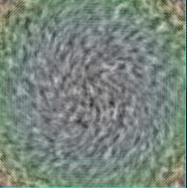
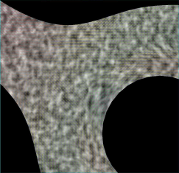
Micro-scale II Quality validation
Various input flow
Please see my webpage for more video results
Rotation
Shear
Free
Boundary
Notes:
Put images here. Various flow.

Slide 120
Micro-scale II Quality validation
Notes:
Show velocity profile.

Slide 121
Micro-scale II Applications
Notes:
Advecting texture is a general prolem, has a wider range than river…

Slide 122
Micro-scale II Discussions: non-noise textures ?
We target textures specified by global properties, e.g. spectrum
Useful for natural flow
For non-noise textures
Many of them work well
High-structured ones
Suffer from “ghosting” effects
Future work: choose best match portion from reference texture

Slide 123
Micro-scale II Discussions
Notes:
Now I show you texture advection with non-noise texture.

Slide 124
Micro-scale II Discussions

Slide 125
Micro-scale II Discussions
Limitation
Patches carry wavelength < kernel size
→ low frequency: treated at the particle level (i.e. simulation)

Slide 126
Micro-scale II: conclusion
A new texture advection method
Lagrangian formalism
Brings decorrelation of texture mapping and regeneration events
Local patches
Ensure continuous texture animation
Provide accurate distortion metric

Slide 127
Outline
Introduction
Previous work
Strategy overview
Contributions
Conclusion

Slide 128
Conclusion
By using our models
One can achieve real-time, scalable, and controllable river animation with temporally and spatially continuous details on current desktop

Slide 129
Future work
Macro-scale
Velocity: more studies on parameters
Influence of slope of river bed
Notes:
We know some qualitive realtion between interpolation parameters and the profile of velocity, but not accurate.
Also, moving boundary need efficient data-structure for update distance.
Also about water depth.
Unsteady water surfaces
Time-variant depth and boundaries

Slide 130
Future work
Meso-scale
Hydraulic jumps, ship waves and wakes ...
Notes:
Images…

Slide 131
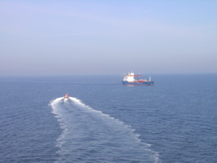
Future work
Micro-scale I: wave sprites
Various reference textures: domain wise control
Sprites density: adaptive to flow condition
Notes:
Also, use images here. Foam …..
Now sprites only adaptive to the view distance. We would like to make it adaptive also to the flow conditions.

Slide 132
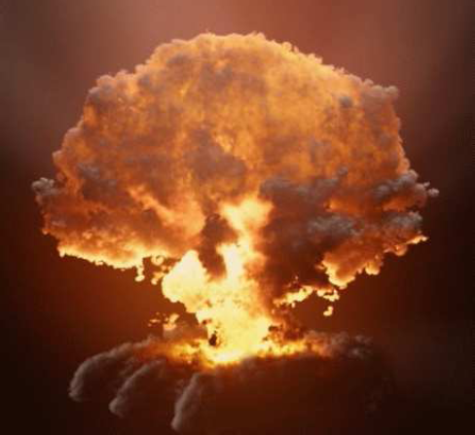
Future work
Micro-scale II: Lagrangian texture advection
Extend to 3D volume
Improve: for high-structured texture
[RNGF03]
Notes:
.

Slide 133
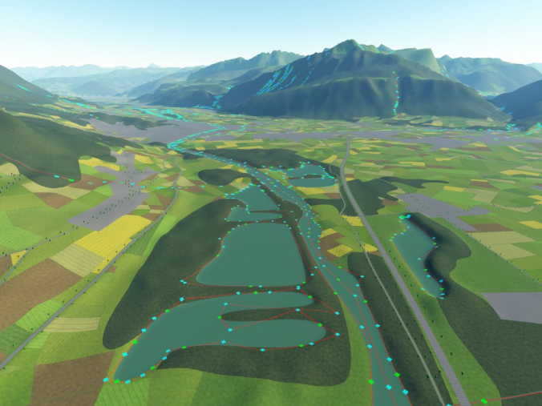
Future work
Put models together
Integrate with existing systems
Google Earth, Proland [BN08], video games …
Google Earth
Proland
EA: Crysis

Slide 134
Thanks

Slide 135
Models of Animated Rivers for the Interactive Exploration of Landscapes
Grenoble Institute of Technology
a Ph.D. Defense by
Qizhi Yu
Under the Advisements of
Dr. Fabrice Neyret
Dr. Eric Bruneton
November 17, 2008

